Slide 1



Smart Mask Identification System
Zhang Yixun 05191256 EIE1909

Slide 2

Introduction
Wearing masks is a necessary method to prevent COVID-19.
Some people are not aware of wearing masks.
Very DANGEROUS especially in middle or high-risk areas.
To help polices or guards to warn passers-by or visitors to wear masks.

Slide 3
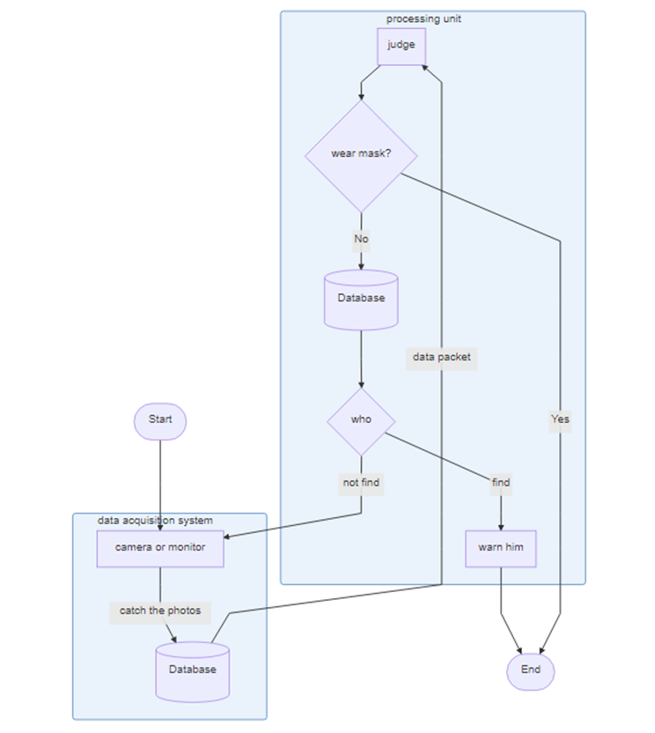

Slide 4
Determine quantities
need acquire and measure face photos to analyze and save in the database.
we use camera to capture the photos and save them as SDI stream
digital signal

Slide 5
Choose the sensors
we do not need high quality, we focus on practicality.
Pixel, focal length, network, trace mode, storage mode, power supply, classification of waterproof, price.
These parameters are what we are concerned about.
After comprehensive consideration, we chose MIPC3126W-4 as the camera

Slide 6
Brands | TP-LINK | MERCURY | EZVIZ
Model | TL-IPC534H-W4-W20 | MIPC3126W-4 | C3WN
Pixel | 300W | 300W | 200W
Focal length | 4mm | 4mm | 3.6mm
Network | Wi-Fi | Wi-Fi | Wi-Fi
Trace mode | intelligent tracking | intelligent tracking | intelligent tracking
Storage mode | memory card | memory card + cloud storage | memory card + cloud storage
Power supply | Power supply | Power supply | Power supply
Classification of waterproof | IP66 | IP66 | IP66
Price | ￥ 299.00 | ￥ 189.00 | ￥ 229.00

Slide 7
Comparison of CCD and CMOS
CCD
CMOS
larger area ratio of the effective photosensitive area to the whole photosensitive element
The electrical signal strength of each image point is increased by the same magnitude
If one of the pixels cannot be operated, the entire row of data cannot be transmitted, so the yield rate of controlling the CCD sensor is low
The image detail loss is serious and the noise is obvious
The electrical signal of each pixel is first amplified and converted into a digital signal, and then gathered to form a binary digital image matrix
Using the most used CMOS process for general semiconductor circuits, the process is relatively simple and the cost is low

Slide 8
Data acquisition system
Smart CMOS image sensors’ two applied fields:
enhance or improve the basic characteristics of CMOS image sensors, such as dynamic range, speed, and sensitivity
realize new functions, such as three-dimensional range search, target tracking and modulated light detection

Slide 9
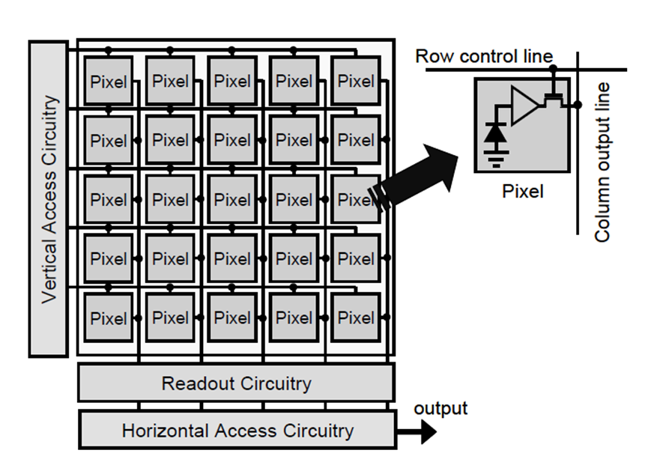
CMOS’s structure
A CMOS image sensor generally consists of an imaging area, which consists of an array of pixels, vertical and horizontal access circuitry, and readout circuitry.

Slide 10
Processing Unit
Two solutions to process :
 | OpenCV | Website
Effectiveness | Low | High
Safety | High | Low
Accuracy | Low | High
Duration | Short | Long
Confidence level | Low | High
Cost | Low | High

Slide 11
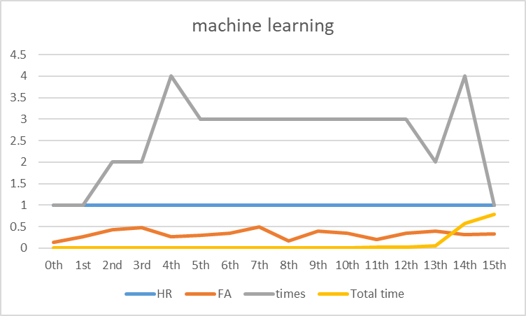

Slide 12
Communications
We need to communicate with the database or processing unit, so we should choose Internet to achieve.
In some places we do not need high-quality transmission, but only need convenient installation: choose a wireless network.
When it is more convenient to install a wired network than a wireless network: choose a more stable wired network. This is also the main factor in choosing the installation location.

Slide 13
Power requirements
 | Cable power supply | Solar power
Stability | High | Low
Resistance | High | Low
Applicability | Low | High
Convenience | Low | High
Cost | Low | High

Slide 14
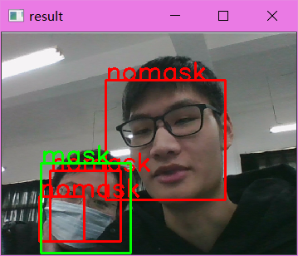

Slide 15
Thank you!

